Slide 1






A Complete Guide To
Module 1: WEBSITE CREATION

Slide 2



Agenda
KEY TOPICS DISCUSSED IN THIS PRESENTATION
Understanding the Website Importance
Understanding Website Basics
Website Creation Tools
Installing WordPress on Localhost using FlyWheel
Install WordPress on Localhost using XAMPP
Applying Security on Your Website Through Wordfence
Installling Other Plugins
Creating your Own Website

Slide 3
Pricing Formula
1
2
4
5
6
3
STEP
STEP
STEP
STEP
STEP
STEP
Product Cost
Marketing
Packaging
Shipping
Overheads
Profit
For example your product cost is 400 pkr
Suppose marketing cost is 300 pkr
Packaging cost is around 50 pkr
Packaging cost is around 250 pkr
Packaging cost is around 50 pkr
Profit?
Product Cost + Marketing + Packaging + Shipping + Overheads + Profit = Selling Price
If the profit is 50 then the entire selling cost is 1050/-
A good business is where one can sell 100+ orders in a day
Now the question here is who will buy 400 rupee thing in 2000? Yes, we all are doing that.

Slide 4

Brand vs Generic Domain Names
Use branded domain names rather than generic ones For Example: Generic: “ladiesbag.com” Branded: “TIFMO, TEMFA, Darri Mooch” Branding helps in marketing and recognition

Slide 5
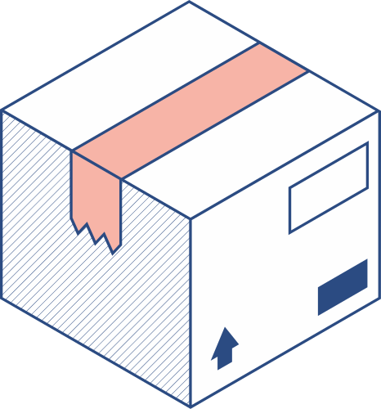


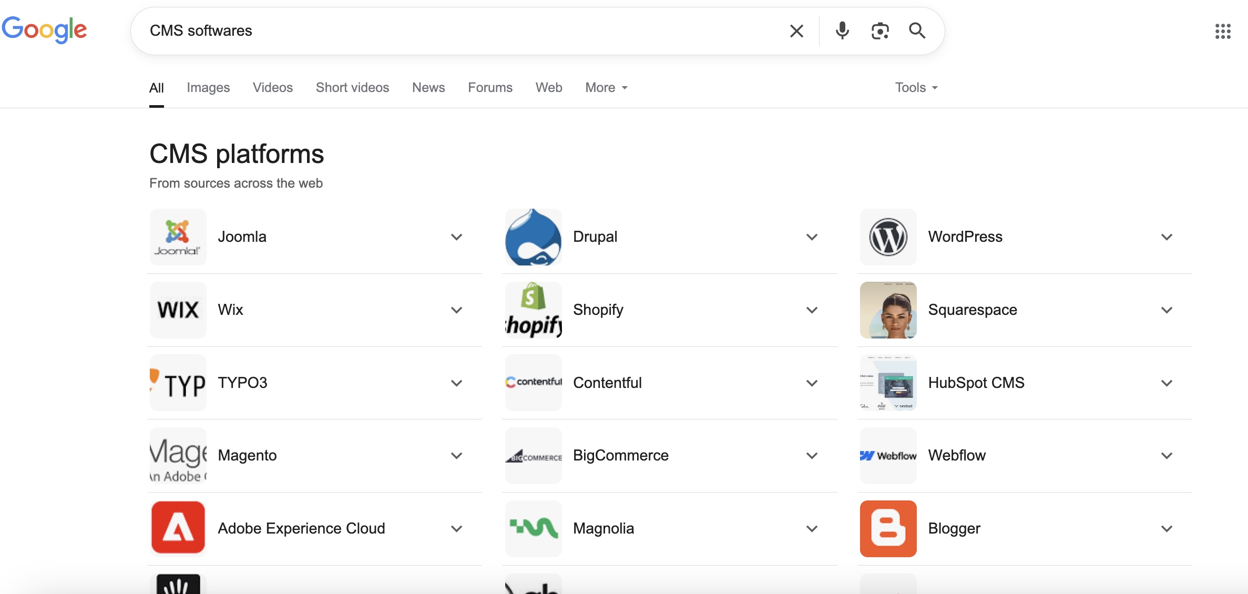
Content Management System (CMS)
CMS allows you to build websites without coding everything manually Examples: Shopify, WordPress, WooCommerce (WordPress plugin for e-commerce) Shopify: E-commerce only WordPress: Versatile for any website type

Slide 6
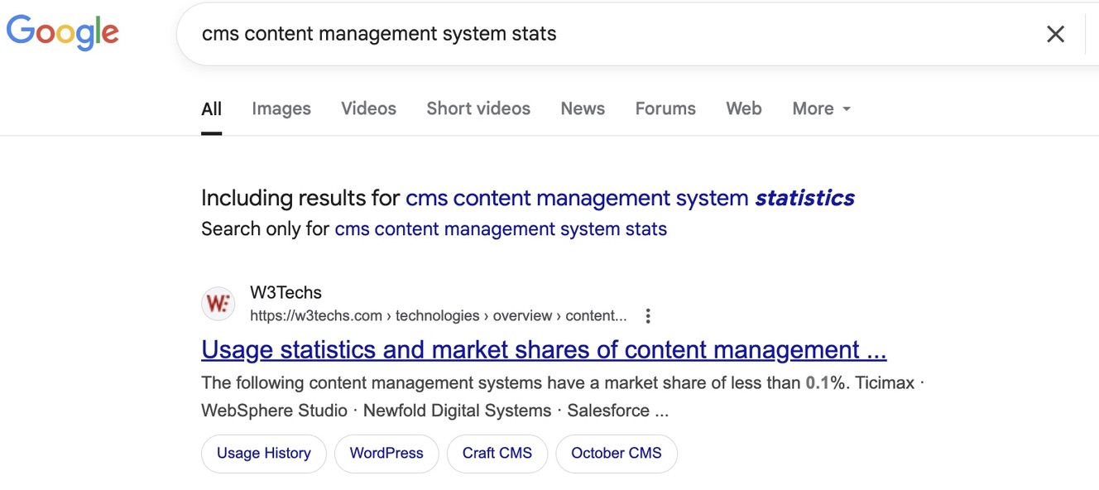
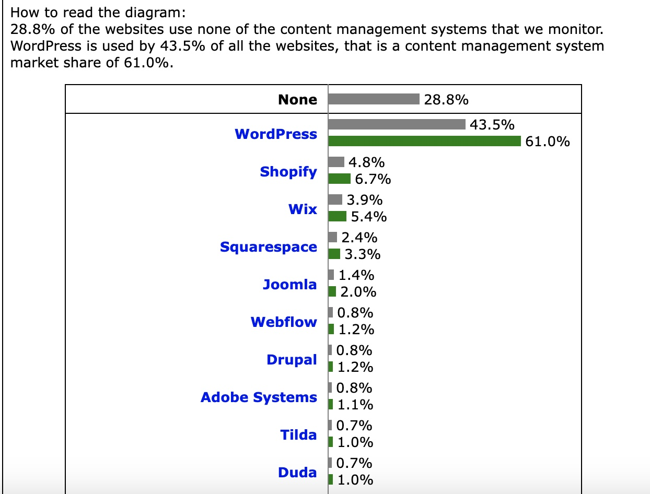
CMS popularity: Check sites like W3Techs for stats

Slide 7


Myth About Shopify vs WordPress Sales
Shopify or WordPress don’t guarantee sales
Sales depend on marketing: social media, SEO, email marketing
Learning WordPress first gives good foundation for Shopify later

Slide 8
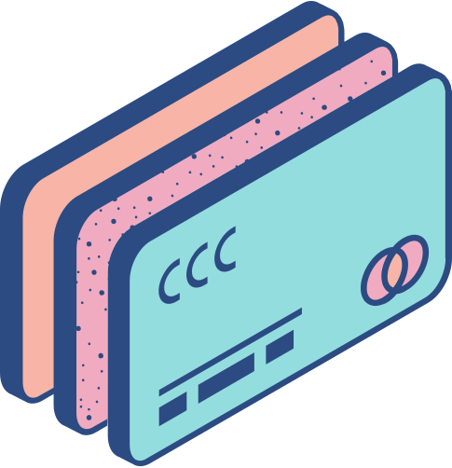
Scenario 1
Client: I want to launch an e-commerce brand. Which platform should I use?
Developer: Shopify is best for e-commerce; it’s user-friendly and popular.
Client: How much does Shopify cost?
Developer: Plans start at $25/month (subject to change). Check shopify.com/pricing for the latest info.

Slide 9

Domain & Hosting Pricing Comparison
Company | Price USD (1st Year) | Price PKR (1st Year) | Price USD ( 2nd Year) | Price PKR (2nd Year)
Bluehost | 35.4 | 13,500 | 163 | 61,600
HostGator | 45 | 17,100 | 92 | 35,000
Namecheap | 28 | 10,600 | 62 | 23,500
TheBeeHost | 45.2 | 12,656 | 45.2 | 12,656
Recommendation: Buy domain and hosting from the same company for convenience

Slide 10

After Buying Domain & Hosting — What Happens?
You receive several important emails after purchase:
Order Activated / Order Received confirmation
Invoice Paid notification
Domain Registered confirmation
Important: Buying a domain gives you ownership confirmation, not login credentials
Think of a domain like a plot of land — you get proof of ownership, not a key
Hosting purchase is different — you do get login details (username & password) to manage your website.

Slide 11
Understanding Your Hosting Account Details
After buying hosting, you receive:
Hosting account username and password
Web Control Panel URL to manage your hosting (e.g., cPanel or DirectAdmin)
DNS information for domain pointing and email setup
The Web Control Panel is your main dashboard to:
Upload/manage website files
Create domain email accounts
Install software like WordPress
Manage security and backups
Control panel URLs can be numerical IP addresses or domain-based (e.g.,192.168.1.1:2082 OR learnwithnimra.com:2082)

Slide 12
cPanel
DirectAdmin

Slide 13
Key Takeaways & Security Tips
Domains do not provide direct login credentials — only proof of ownership | Hosting gives you the actual access to manage your website through a control panel | Keep your hosting username, password, and control panel URL safe and confidential
Use the control panel regularly to maintain your website, emails, and security settings |  | Save all emails from your hosting provider — they contain critical info for managing your site

Slide 14
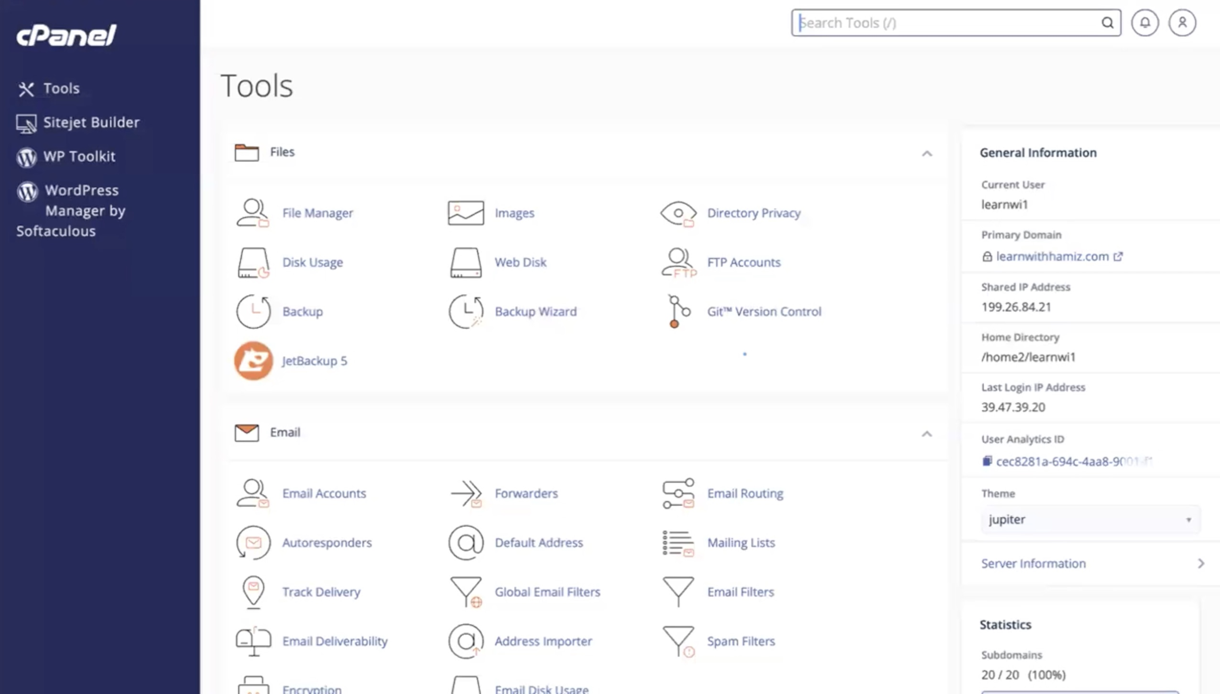
Logging into cPanel & Main Dashboard
Login: Enter the credentials emailed by your hosting provider Dashboard Overview: File Manager: Upload/download files Disk Usage: View space consumption Backups: Manage site backups Support: Access help tickets or knowledge base Images: Browse and optimize media Addon Domains: Attach additional domains, and many other options

Slide 15
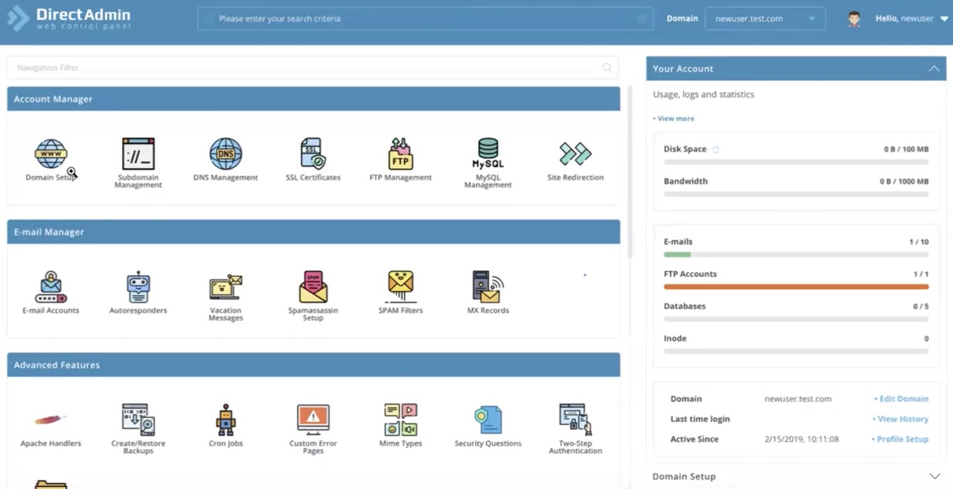
Logging into DirectAdmin & Main Dashboard
Login: Use the same credentials from your provider Dashboard Overview: Very similar feature set (File Manager, Backups, Domain Manager, etc.) Key Difference: Only the look & layout change—functionality is identical to cPanel

Slide 16


Now tell me !
You have your phone in one hand and a charger in the other. You plug the charger directly into the phone—does it charge?

Slide 17

DNS Analogy – Why It Doesn’t Charge
Answer: No - it needs a power socket in between
So just like:
Socket — charger — mobile = charging
Same is the case with website:
Domain — DNS — Hosting = live website
Takeaway: DNS acts as the “socket,” linking your domain to your hosting

Slide 18
What DNS Looks Like?
Every DNS record comes in pairs (minimum two; can have 3–6+)
Examples:
ns1.thebeehost.com & ns2.thebeehost.com
dns1.namecheaphosting.com & dns2.namecheaphosting.com
ns1.hostgator.com & ns2.hostgator.com
Note: You only need to enter the ones your provider gave you

Slide 19
Practical DNS Setup Steps
Gather your DNS from hosting provider: e.g.
ns1.thebeehost.com
ns2.thebeehost.com
Log in to your domain registrar:
Use the same client-area credentials you set up before buying hosting
Here you will see a Domain option, go to Domains and then Active Domains
Now the next step is to select your domain and then pick the option Nameservers
Now enter only the provided DNS and click on Save

Slide 20
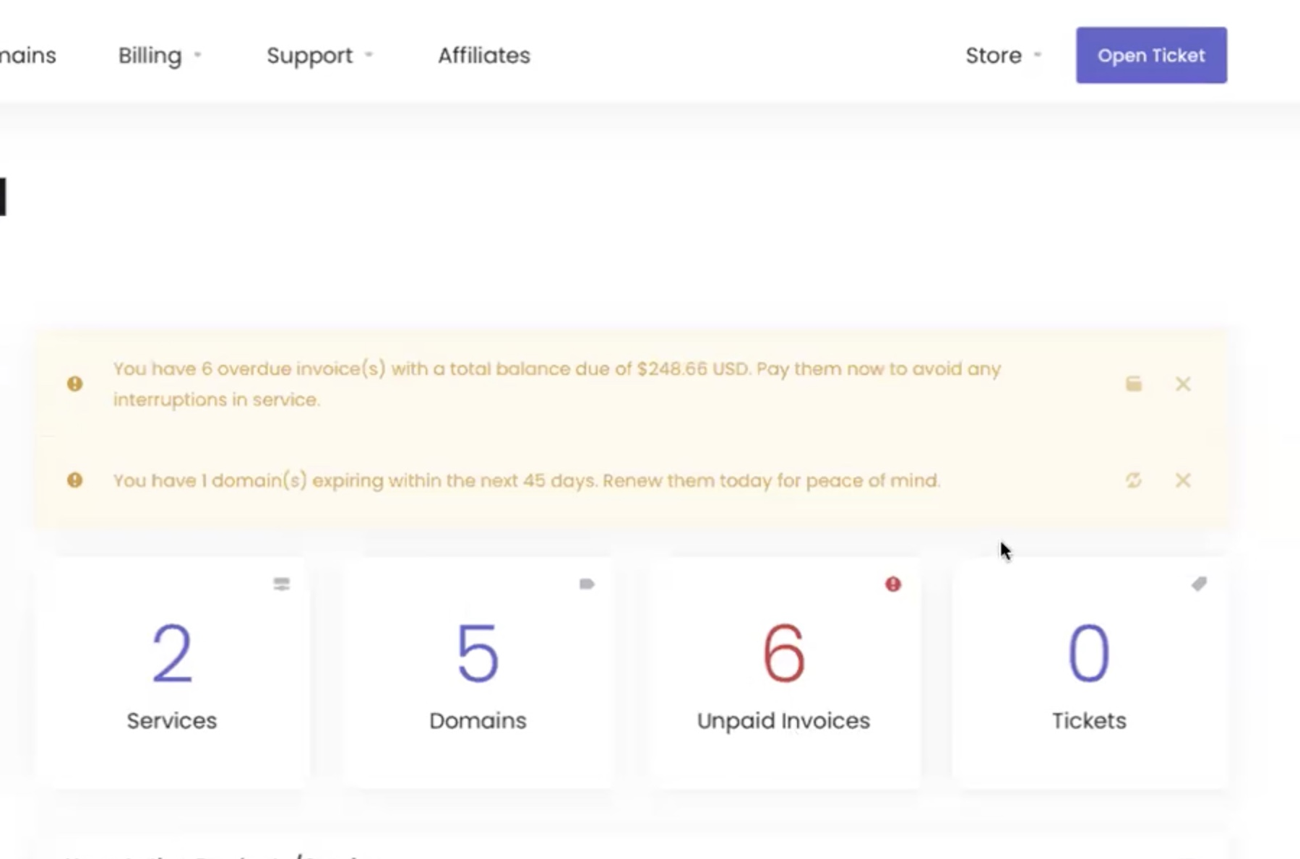
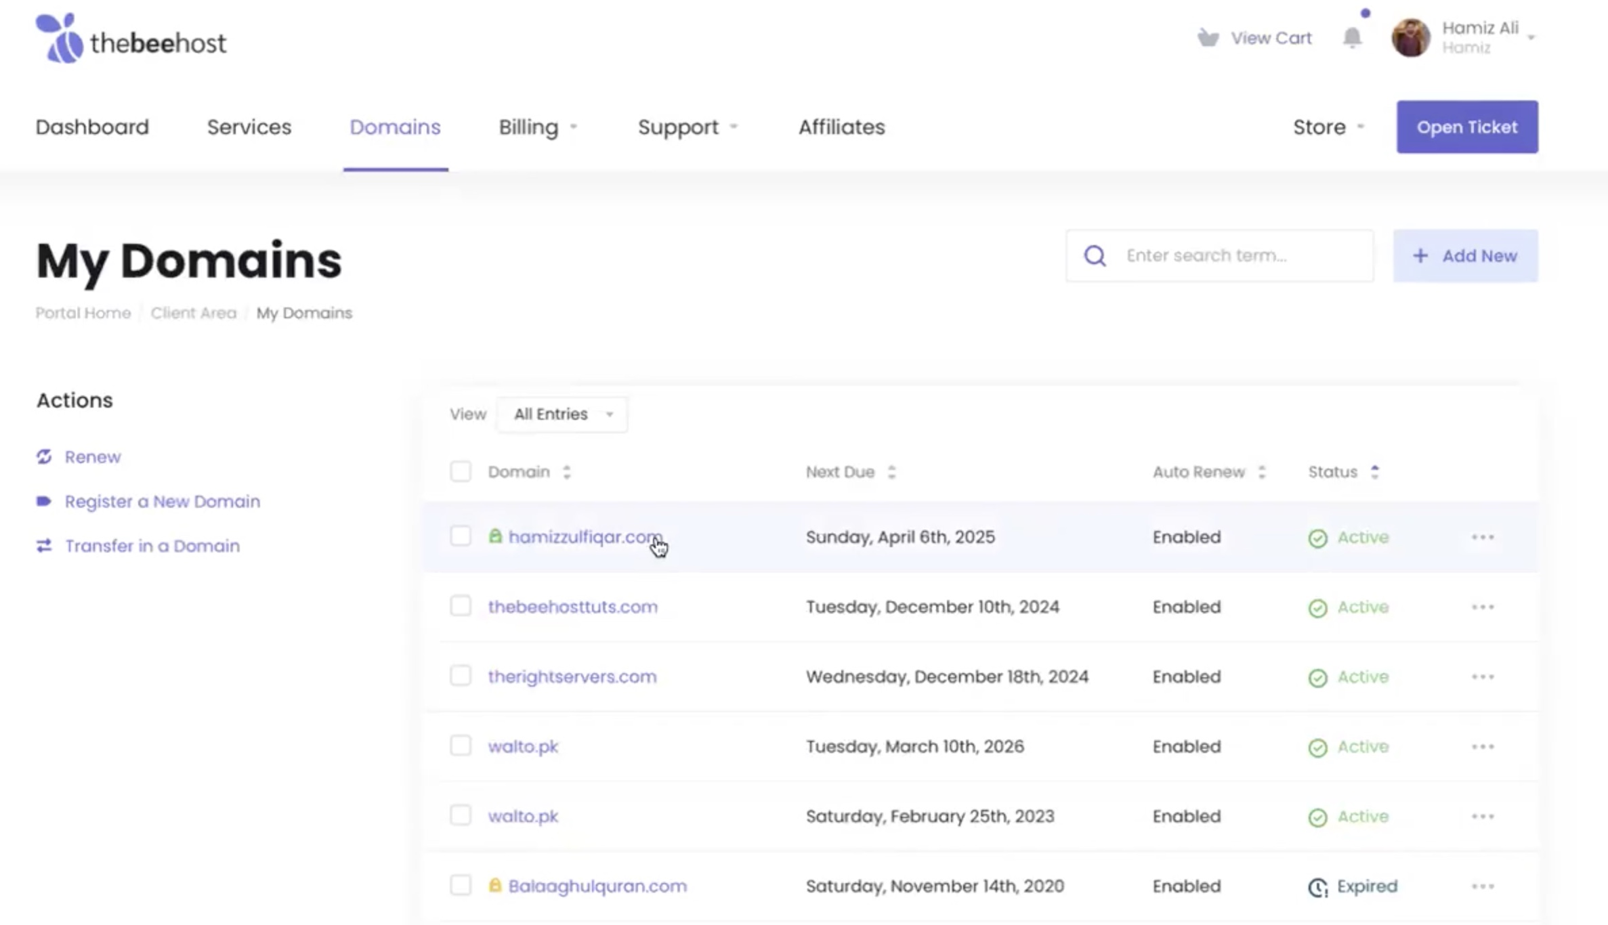
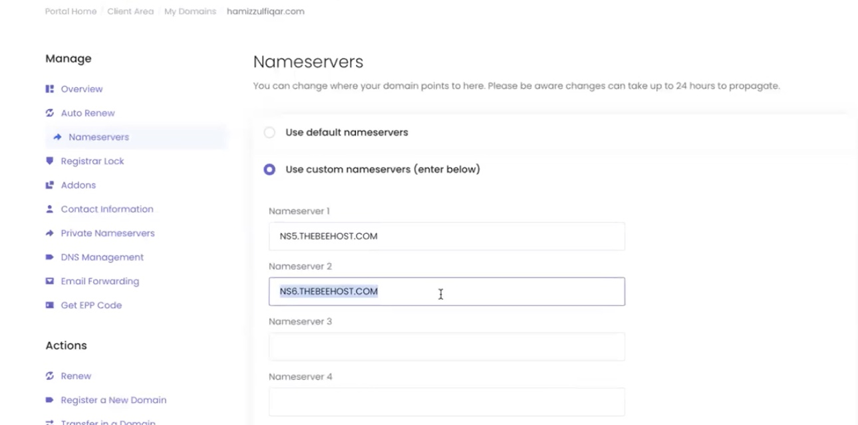
Notes:
here (second hour)

Slide 21
Website Creation Tools

Slide 22
Wordpress Guide
Introduction to WordPress
Two “flavors”:
WordPress.org (self-hosted, free to customize)
WordPress.com (hosted service, monthly fees, limited control)
Downloading WordPress.org
Go to: wordpress.org → Get WordPress
Click Download: software ZIP will save to your system
Cost: WordPress.org itself is free; you only pay for the domain and hosting

Slide 23
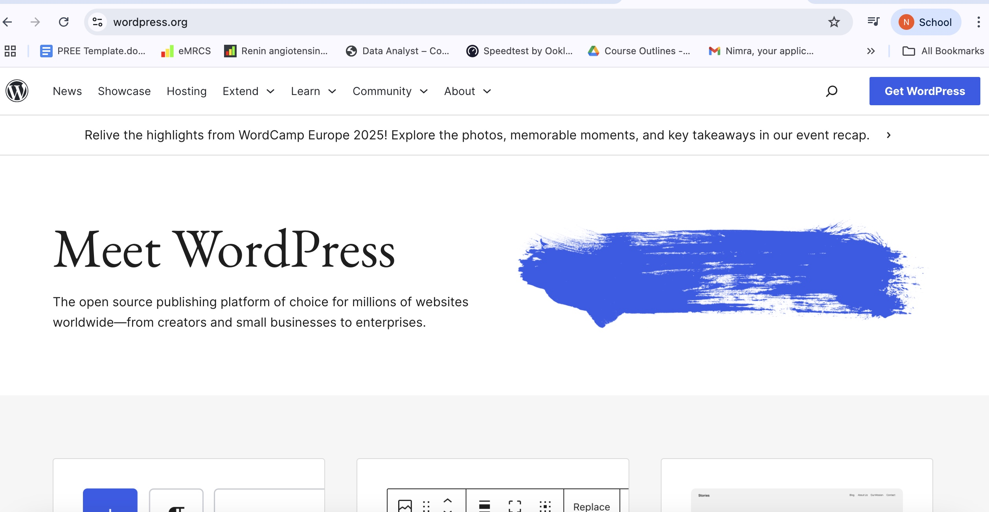
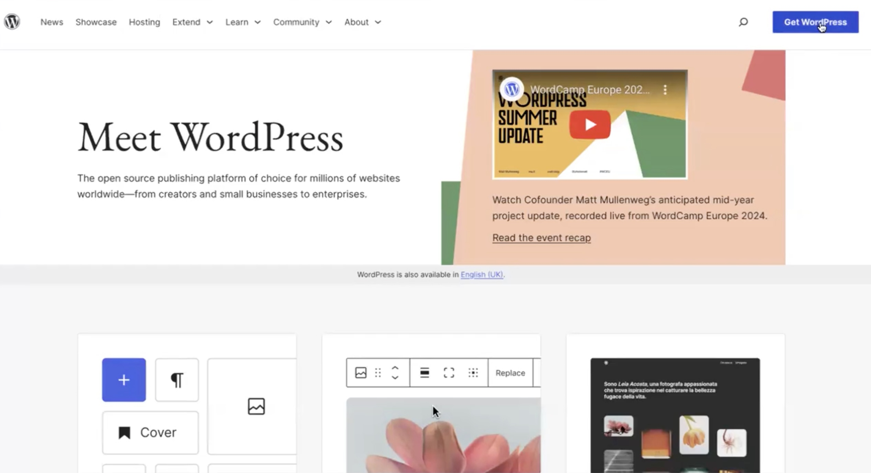
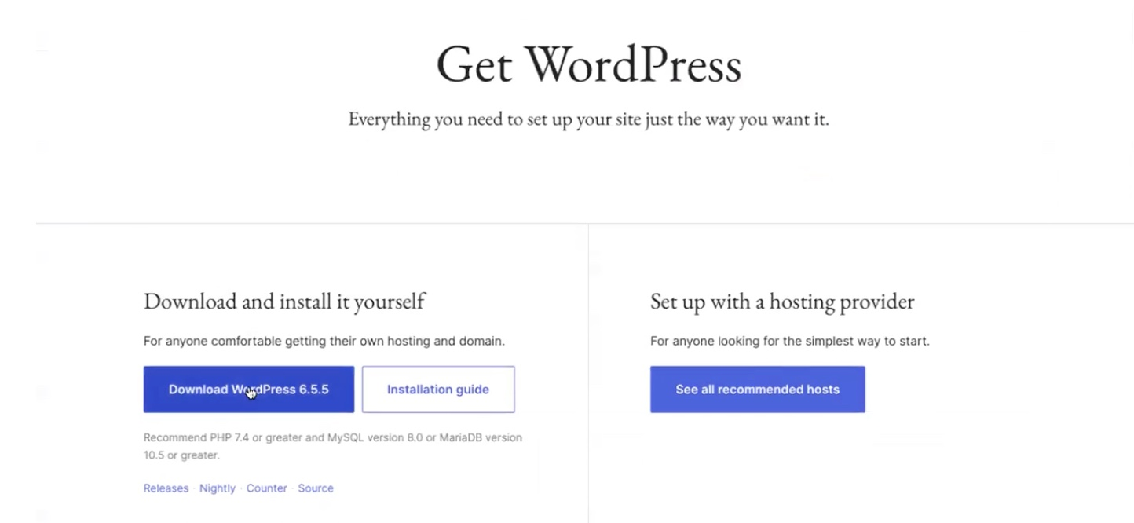
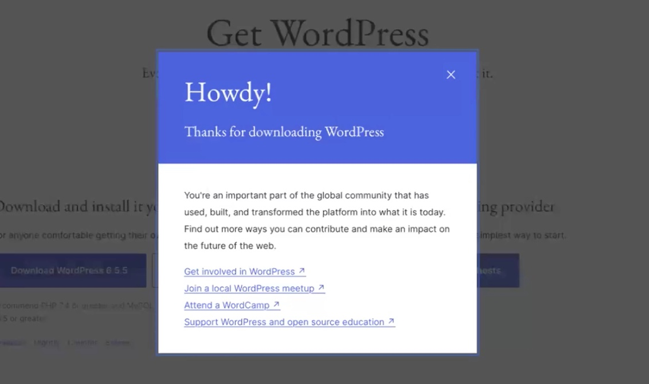

Slide 24
One-Click Install via cPanel / DirectAdmin
Open cPanel/DirectAdmin (via link in your email)
Locate “WordPress Manager by Softaculous” or “Softaculous Apps Installer”
Choose WordPress and Fill in the form:
Site name, admin username & password, desired directory
After this, click Install → Success!

Slide 25
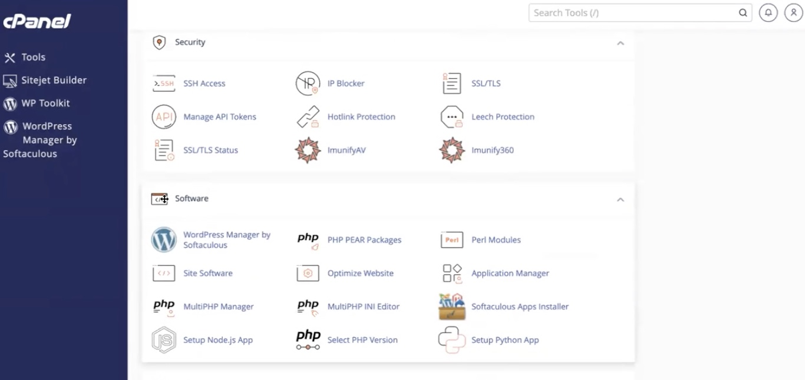
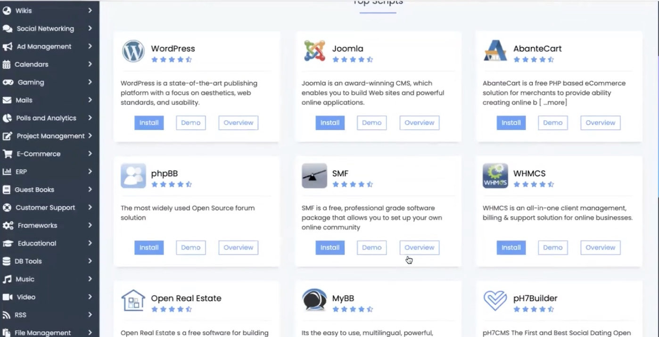
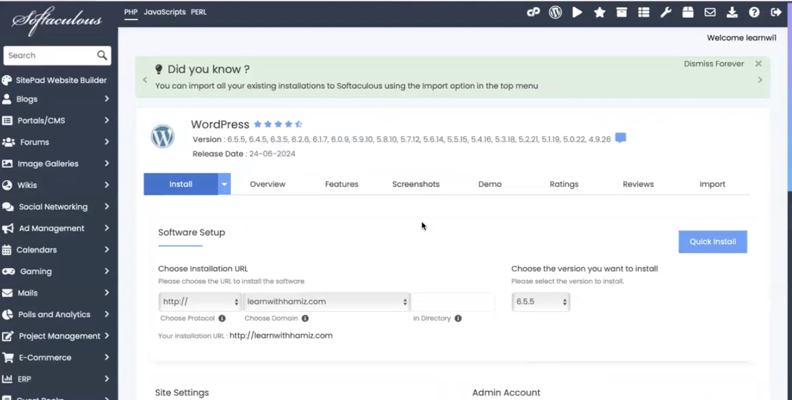
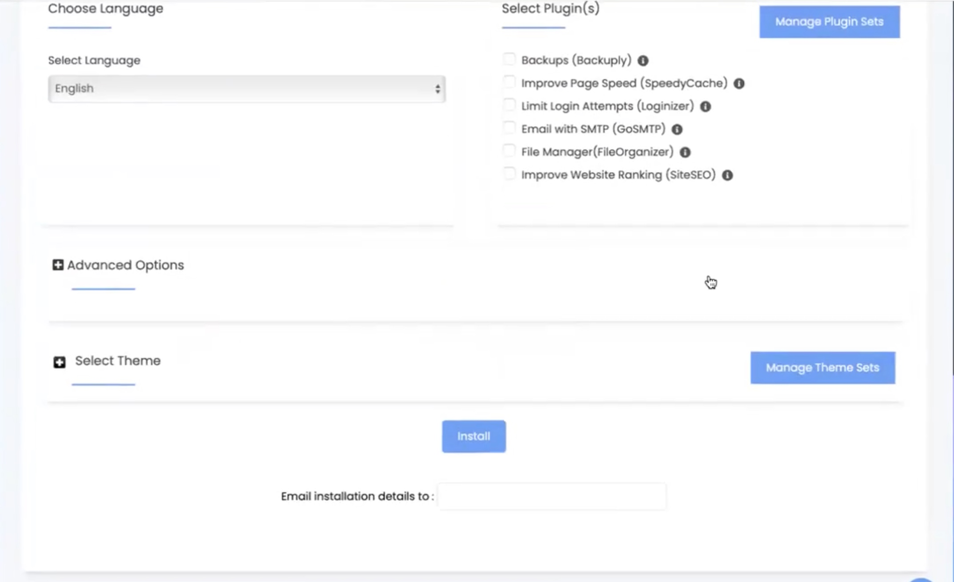

Slide 26
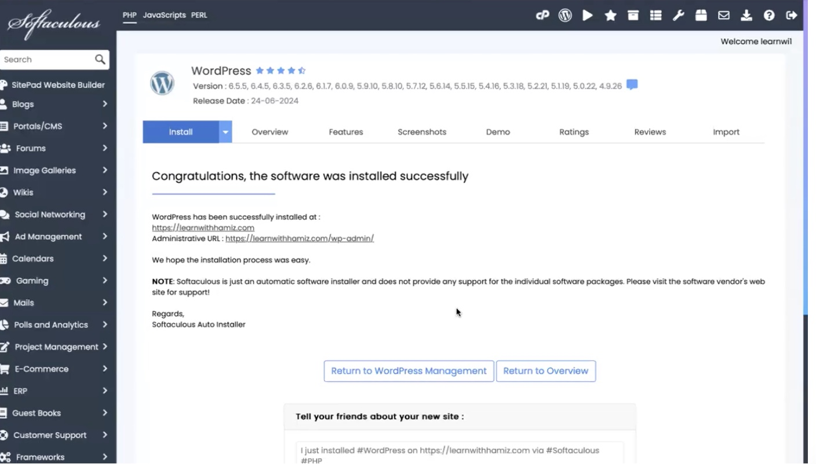
Installed Successfully

Slide 27

End of Lecture

